Slide 1


Quantum Dynamics Simulations of Polariton Spectroscopy
Mohammad Elious Ali Mondal
Department of Chemistry, University of Rochester

Slide 2
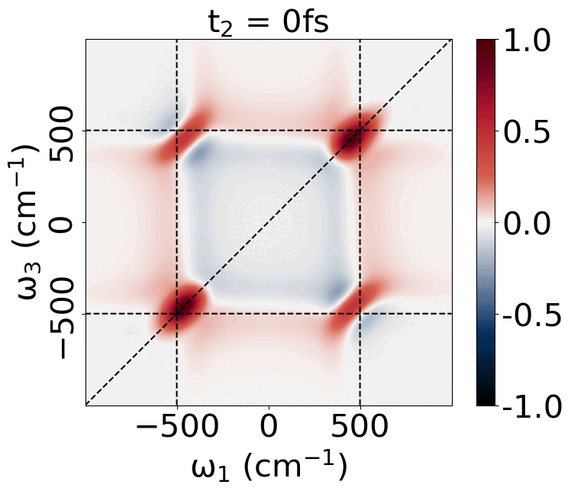
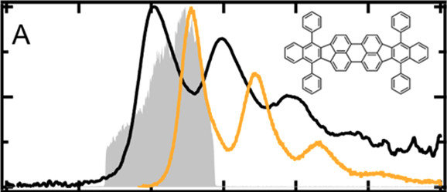
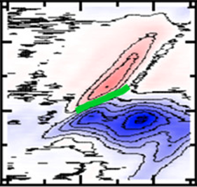
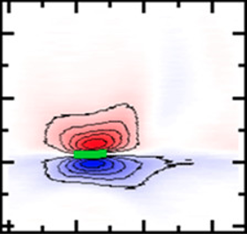
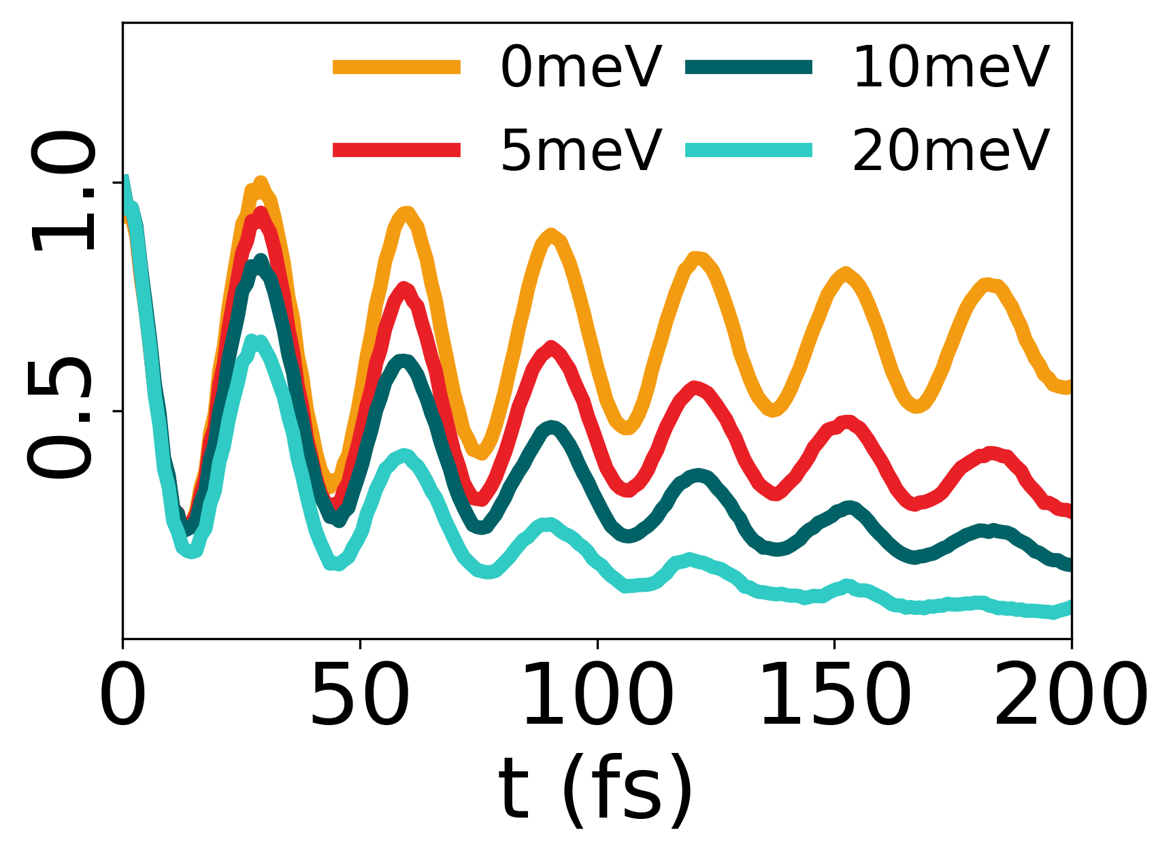
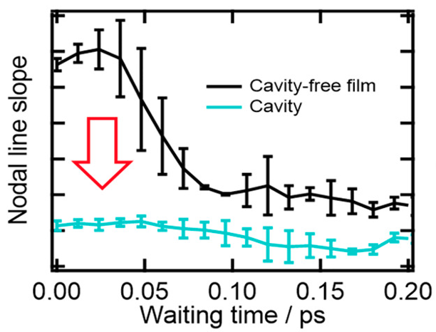
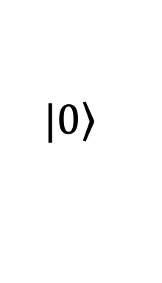
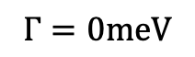
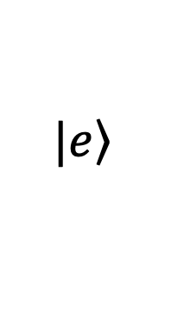

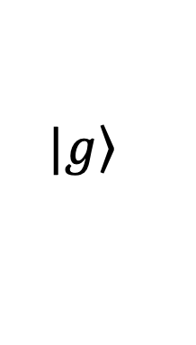
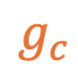
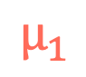
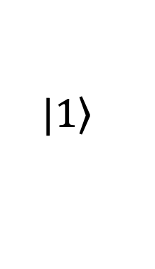
Overview
Polaritons
Spectroscopy
Results
$$Γ=0meV$$
$$g_{c}$$
$$|\left.1\right\rangle$$
$$|\left.e\right\rangle$$
$$μ_{1}$$
$$Γ$$
$$|\left.g\right\rangle$$
$$|\left.0\right\rangle$$

Slide 3
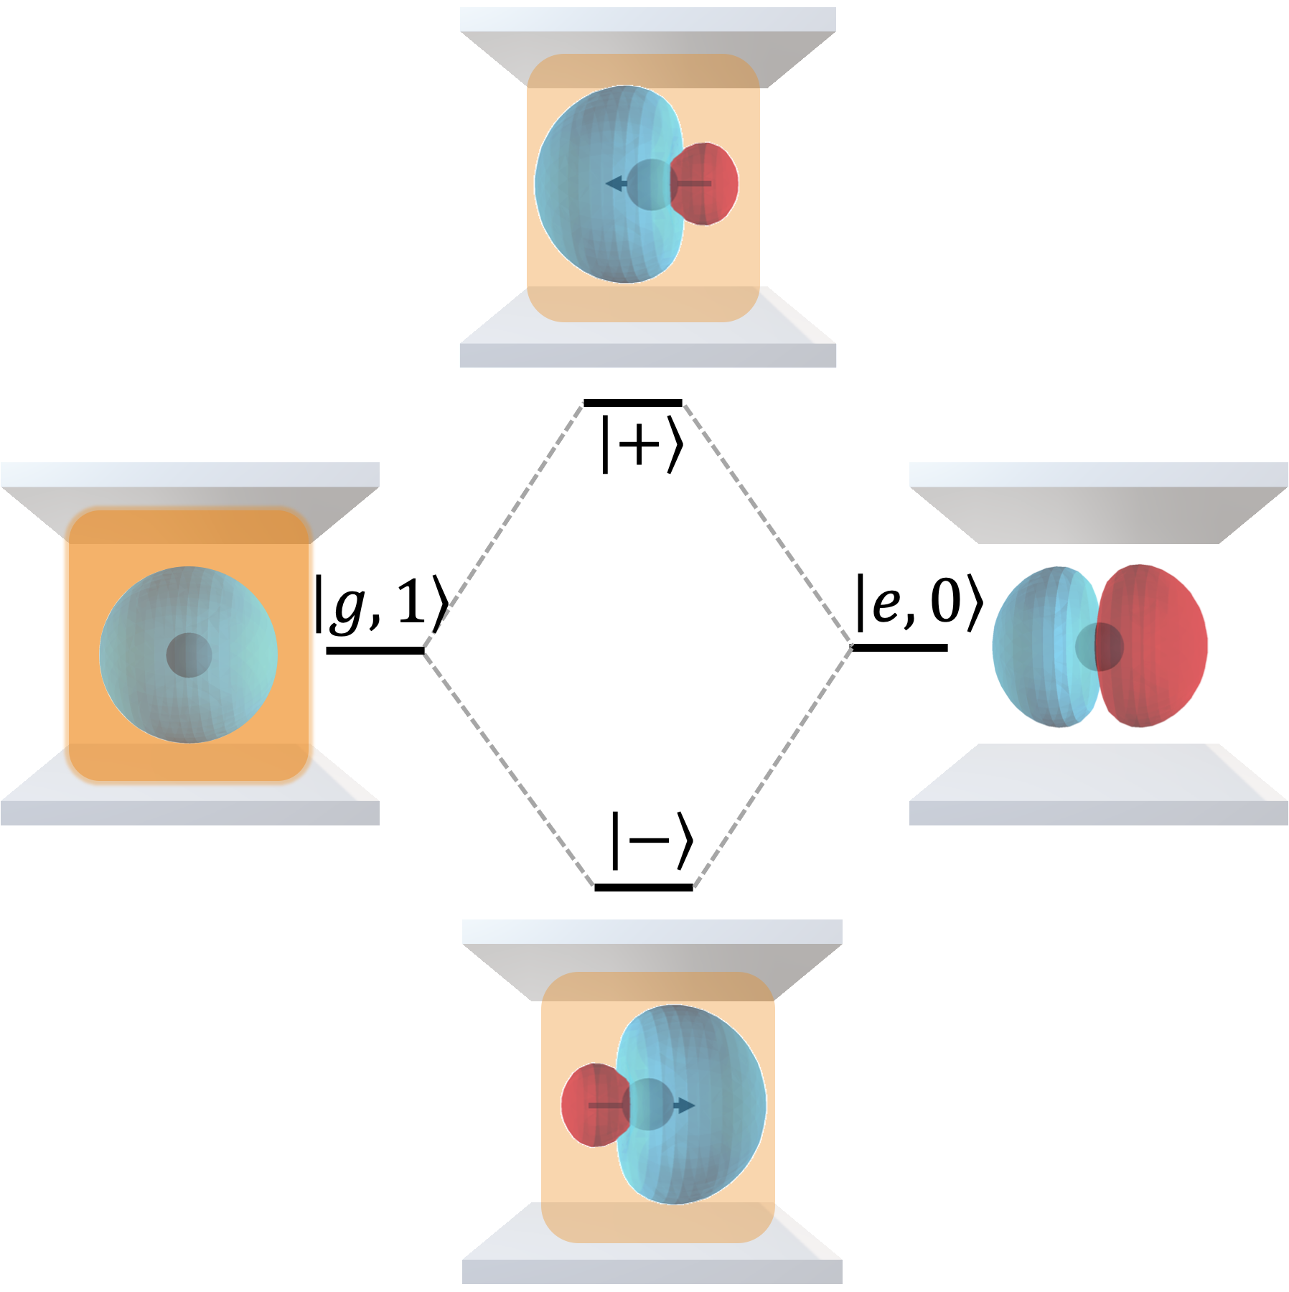
Polaritons
Polaritons: Exciton-Photon Hybridization
Jaynes-Cummings (JC) Model

Slide 4

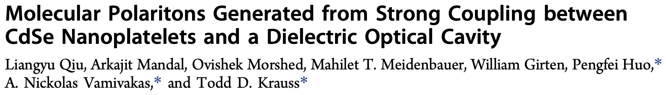
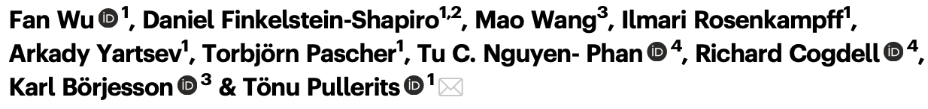
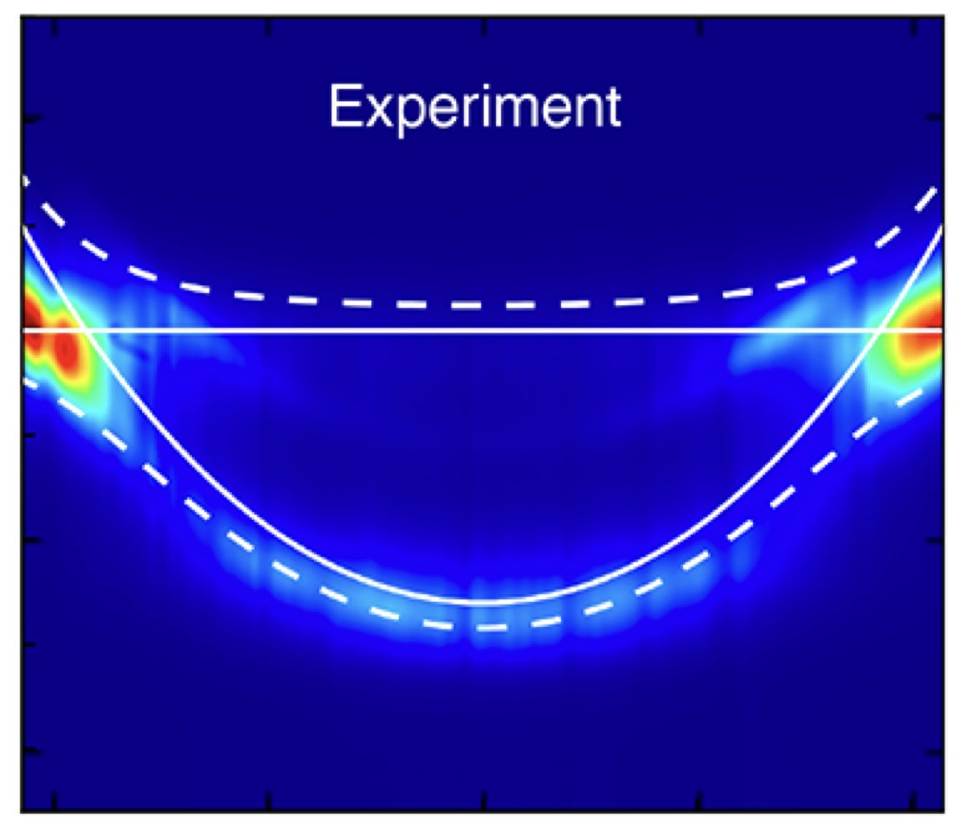
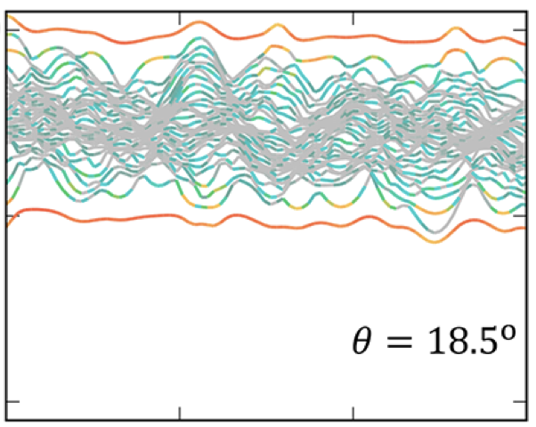
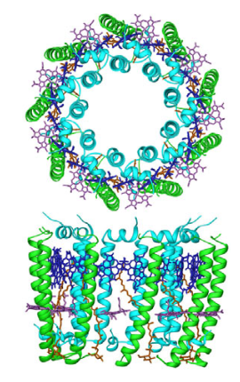
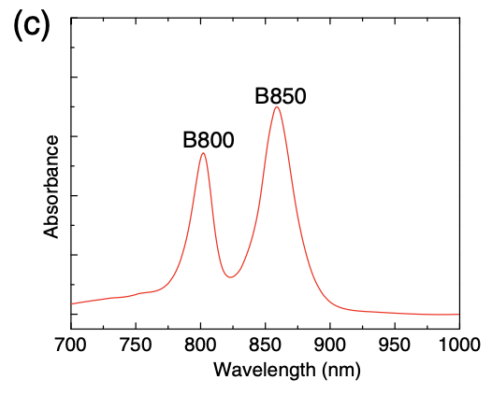
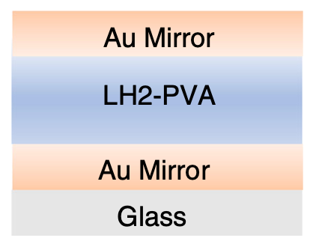
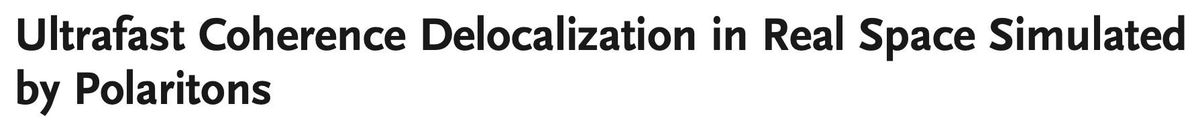
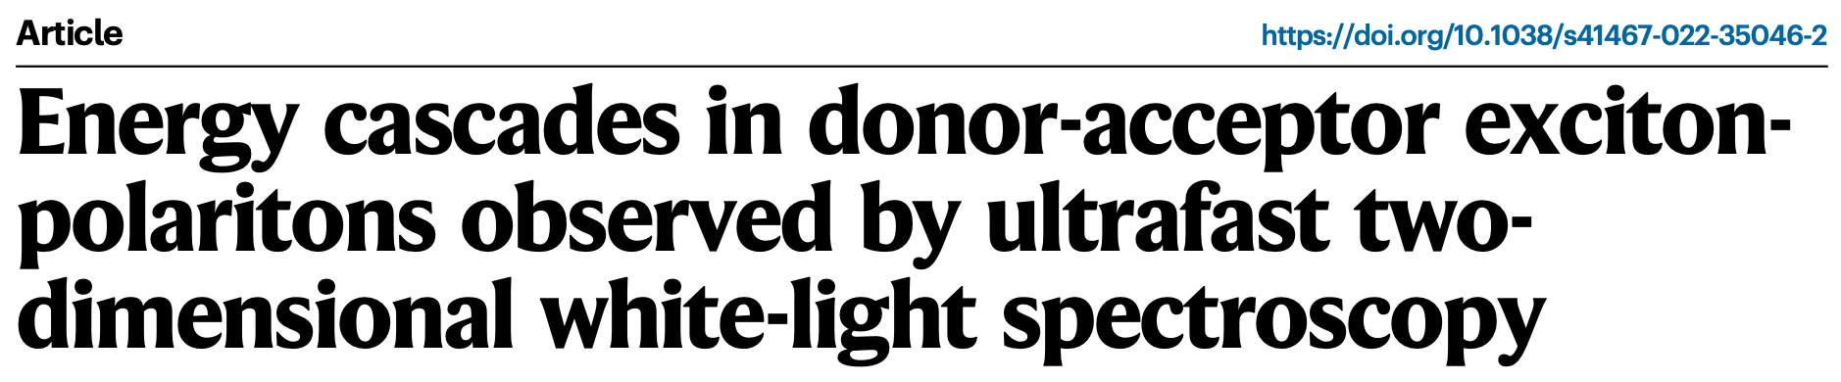
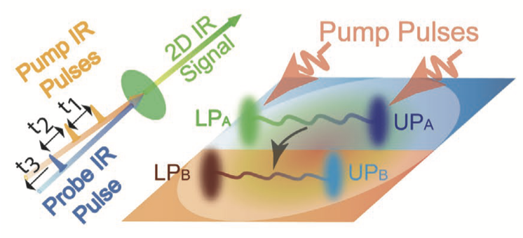
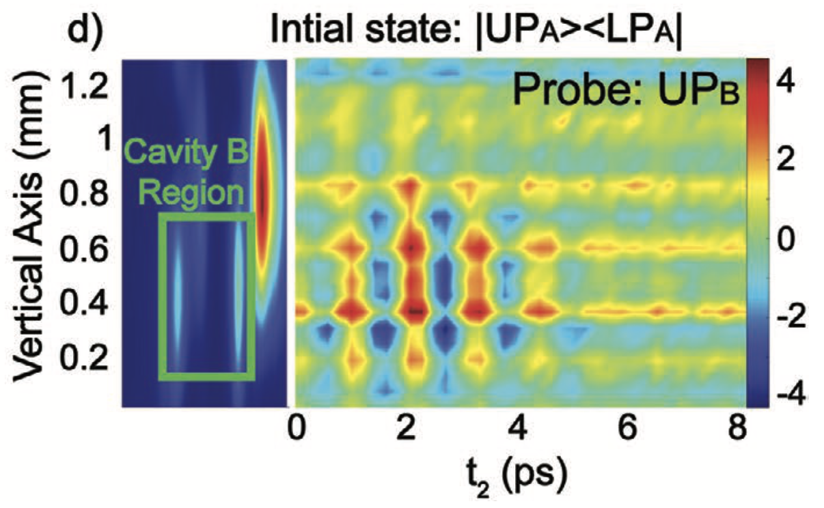
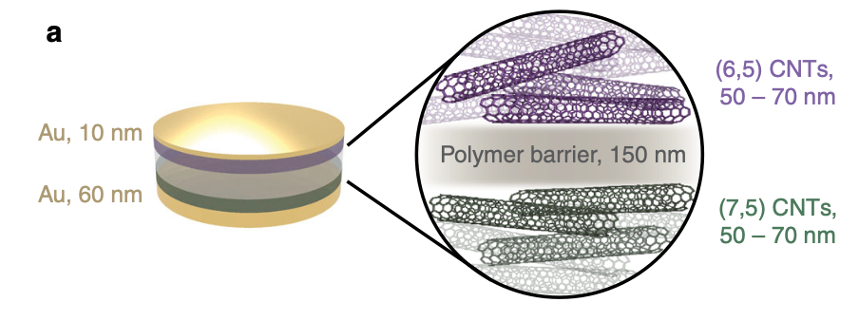
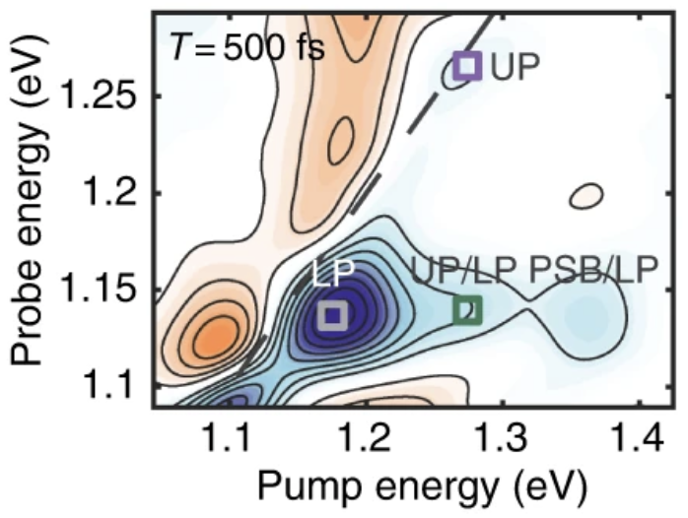
Recent experiments

Slide 5
Polaron decoupling in organic polaritons

Slide 6
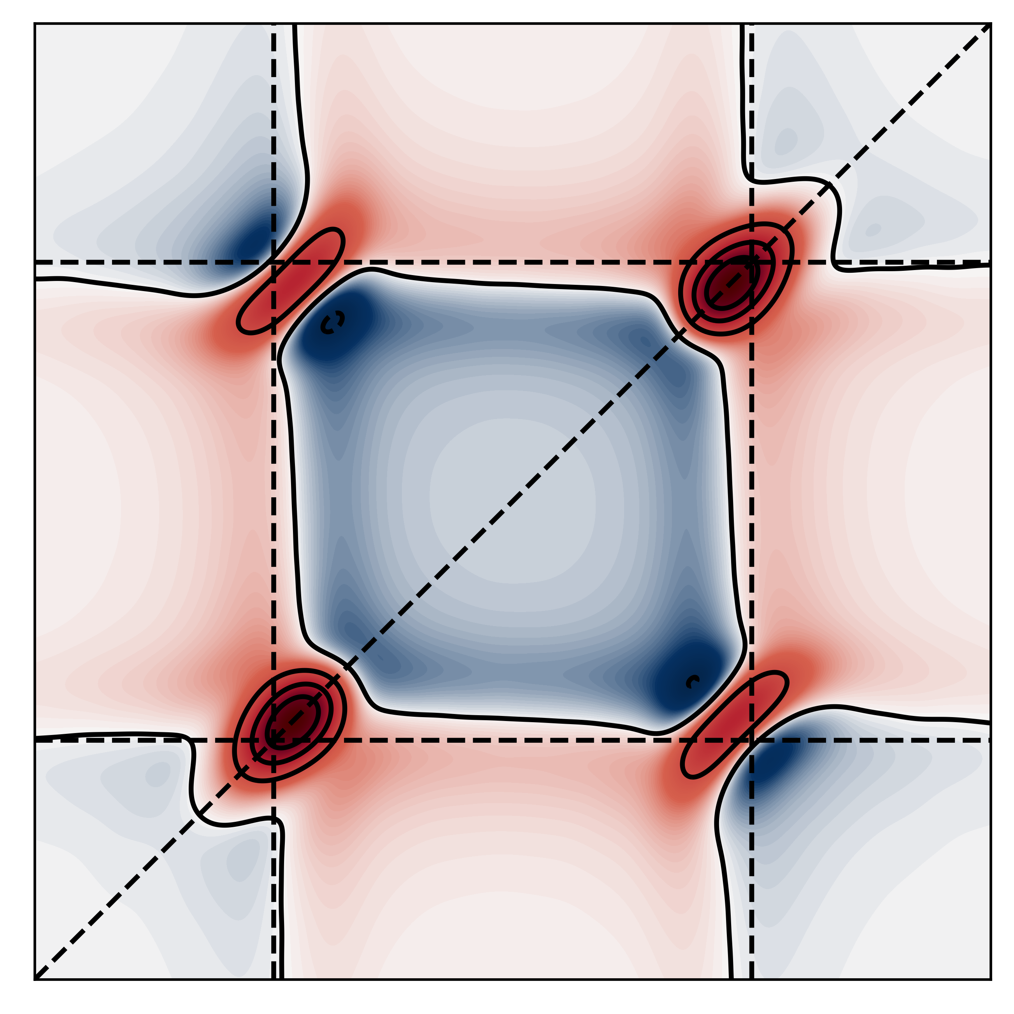
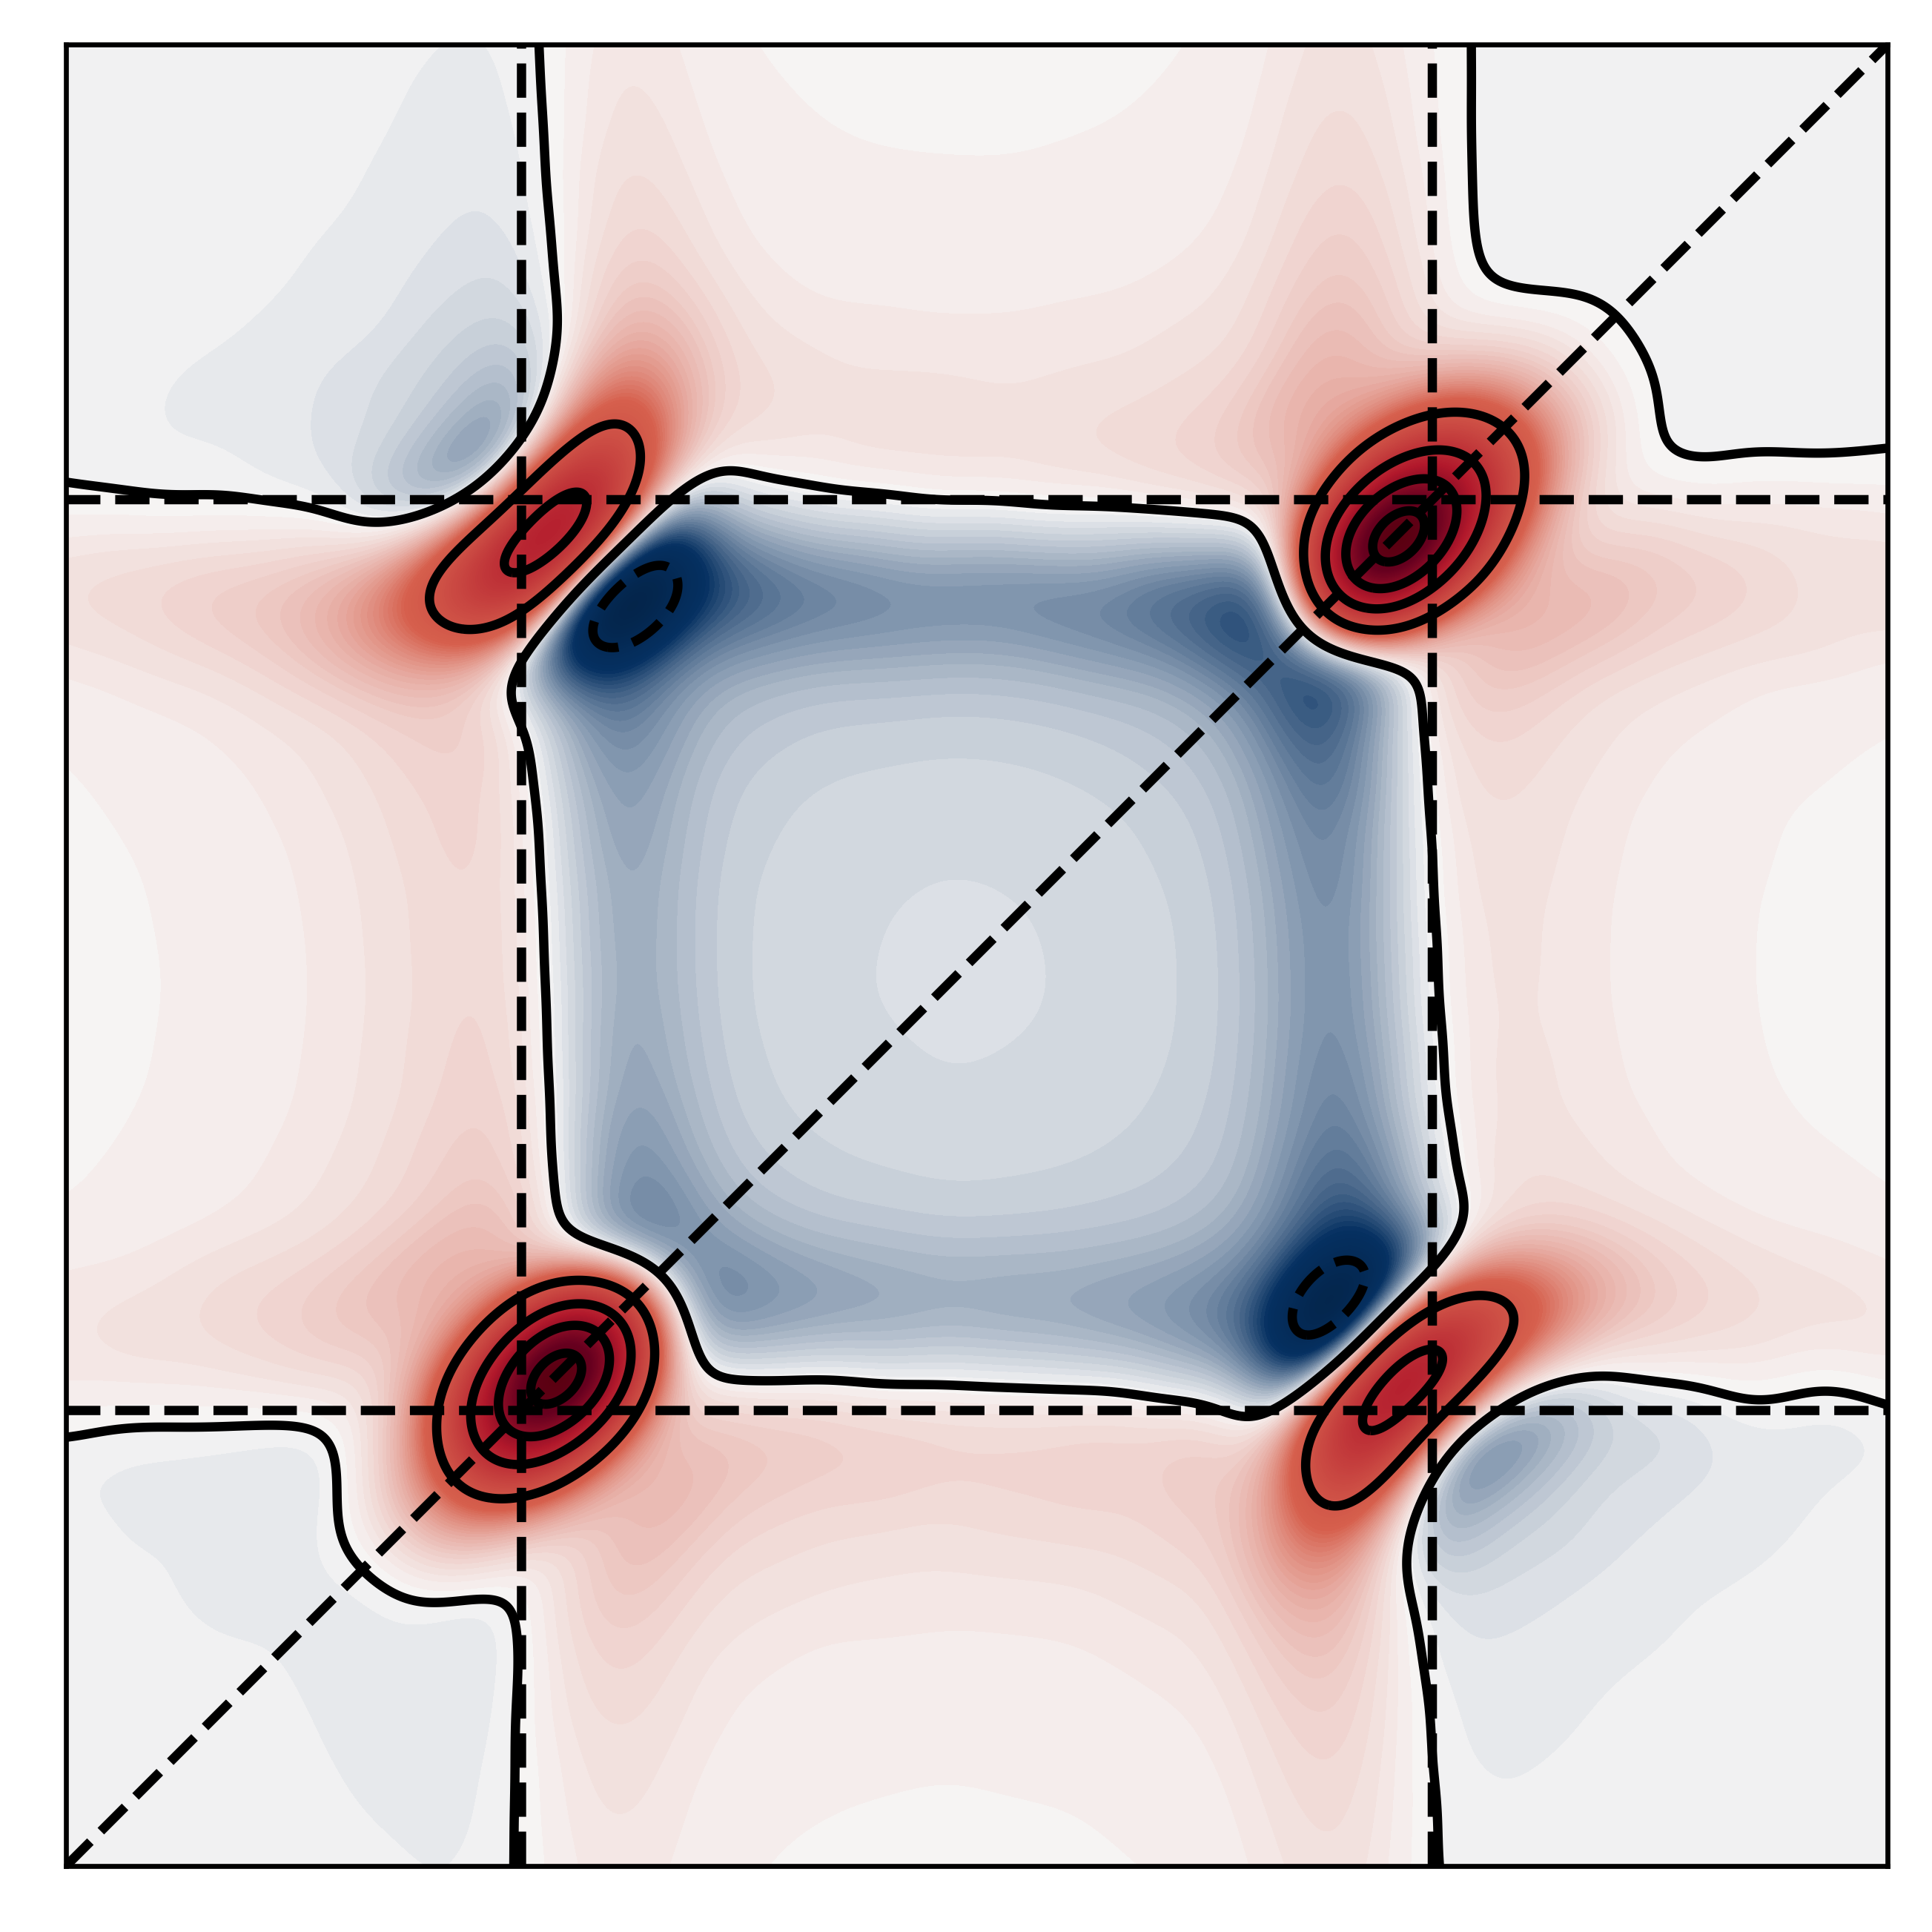
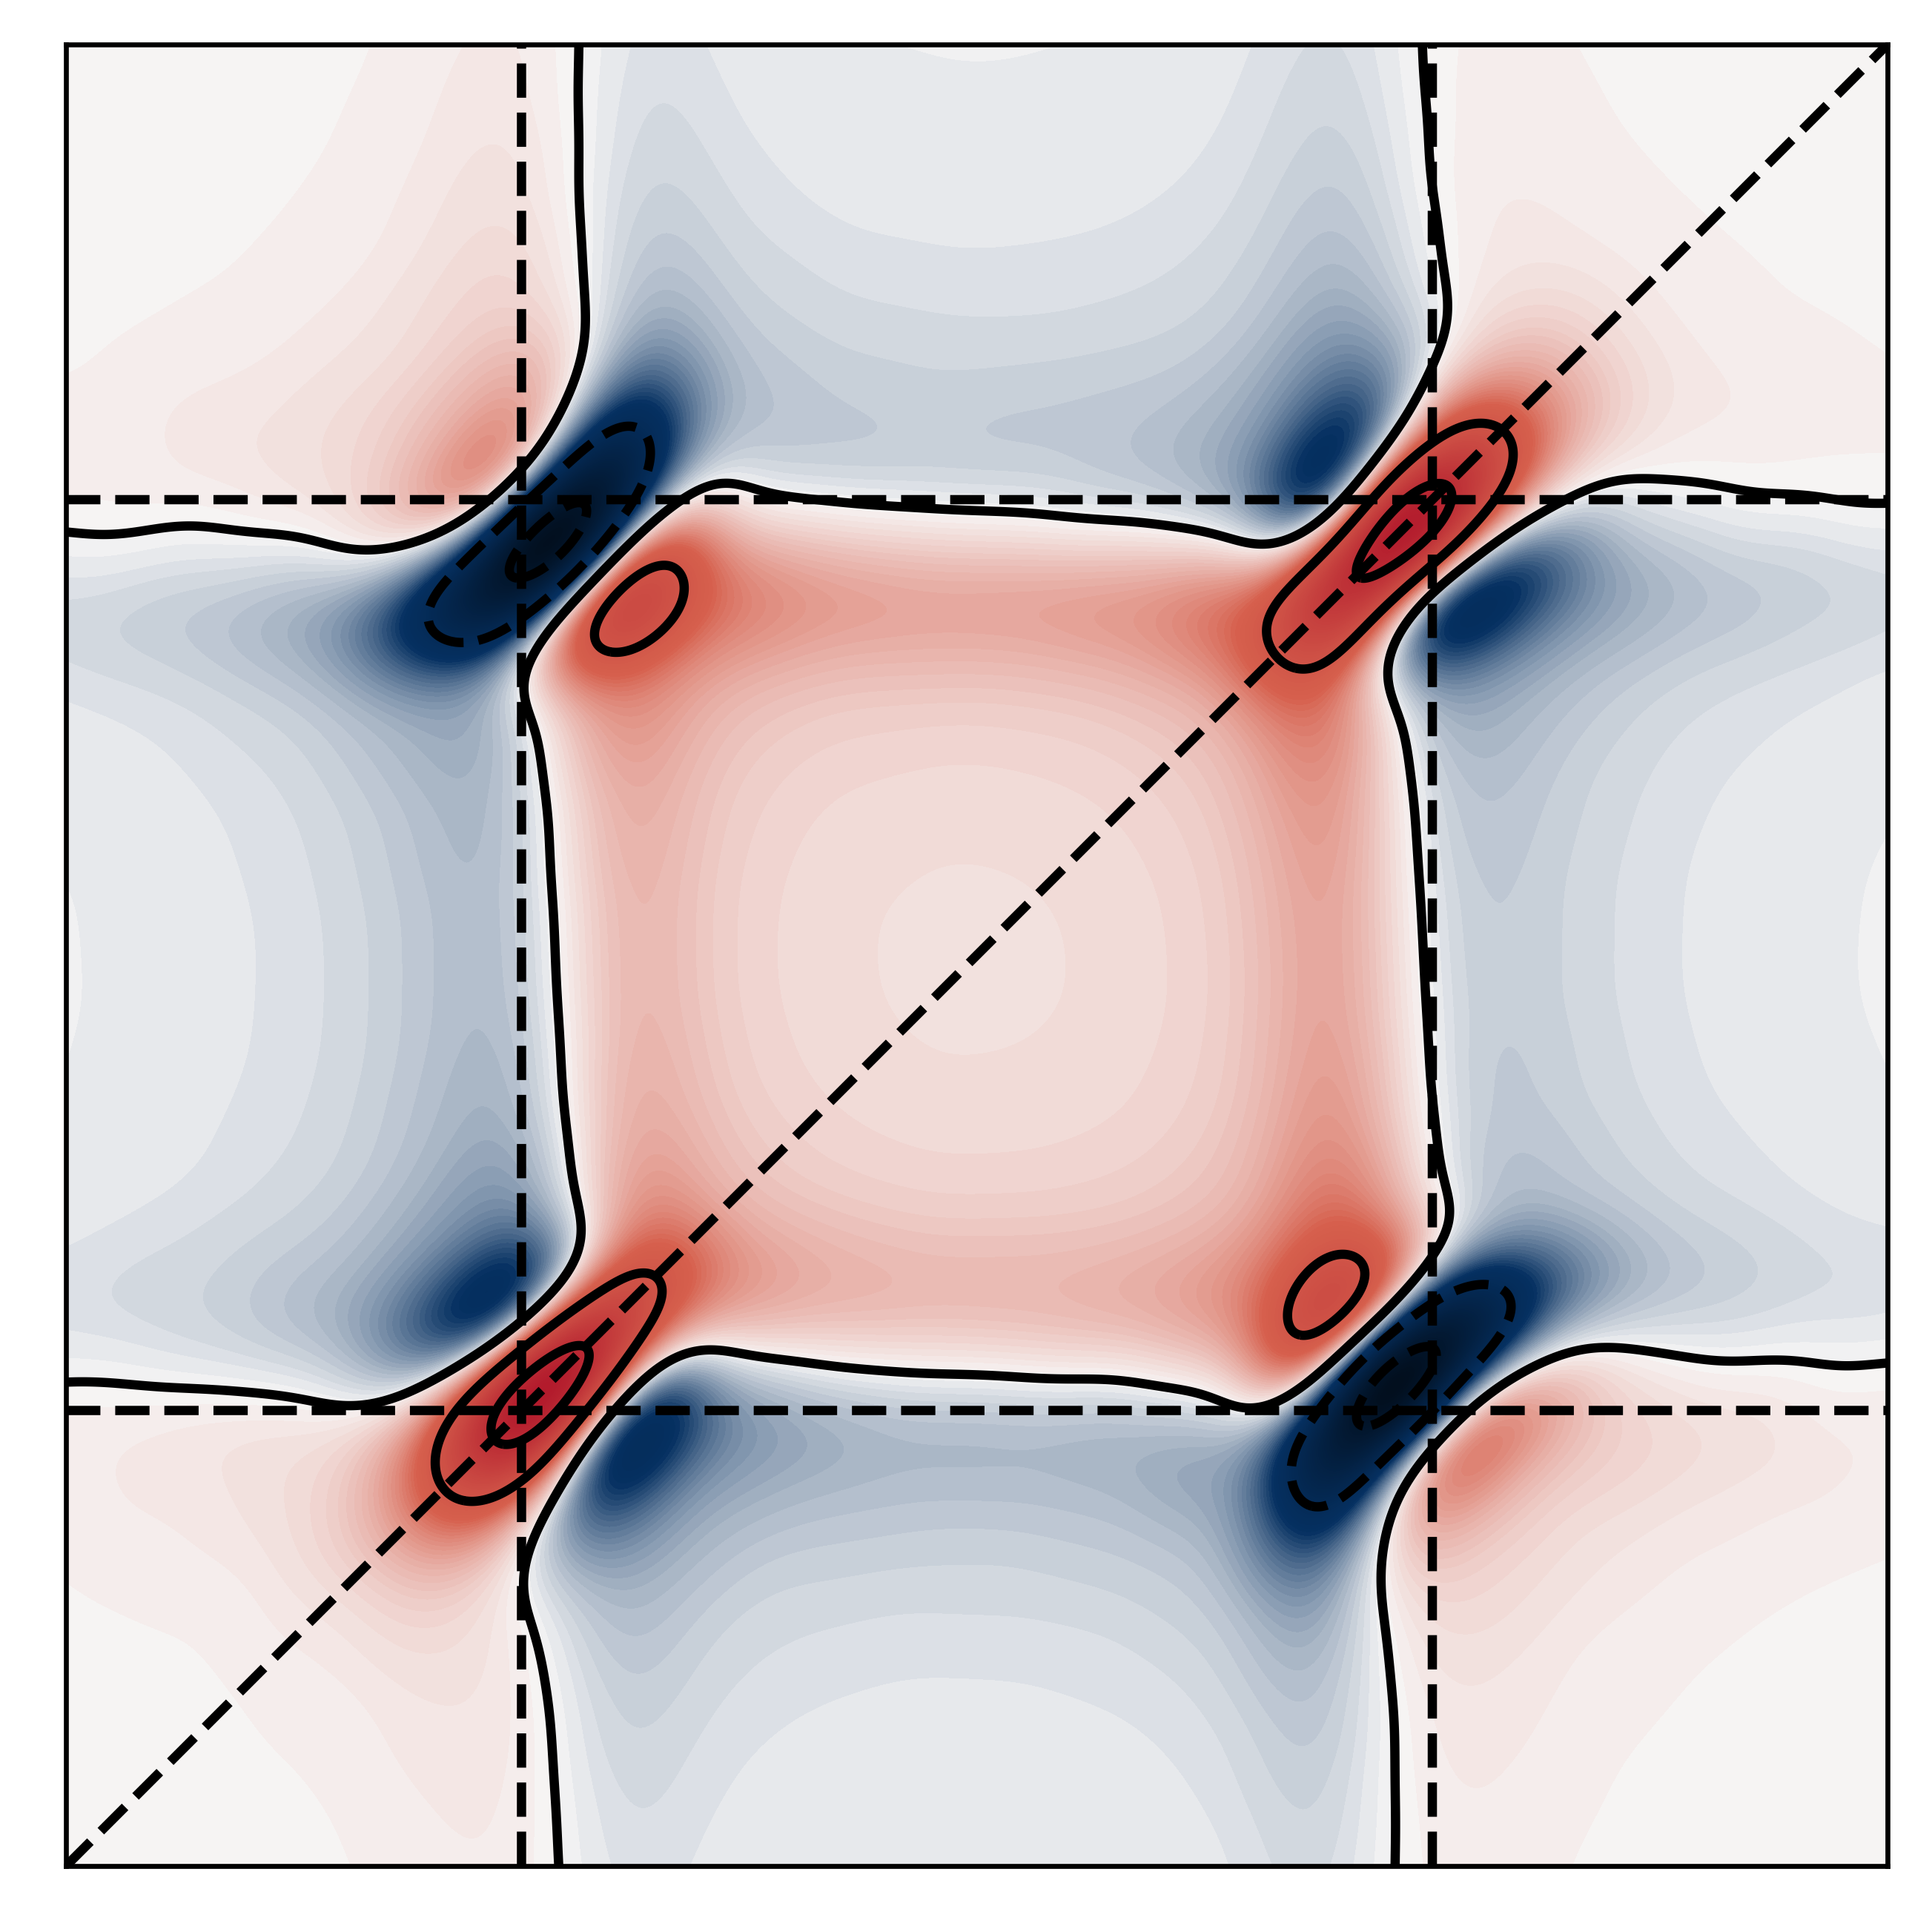
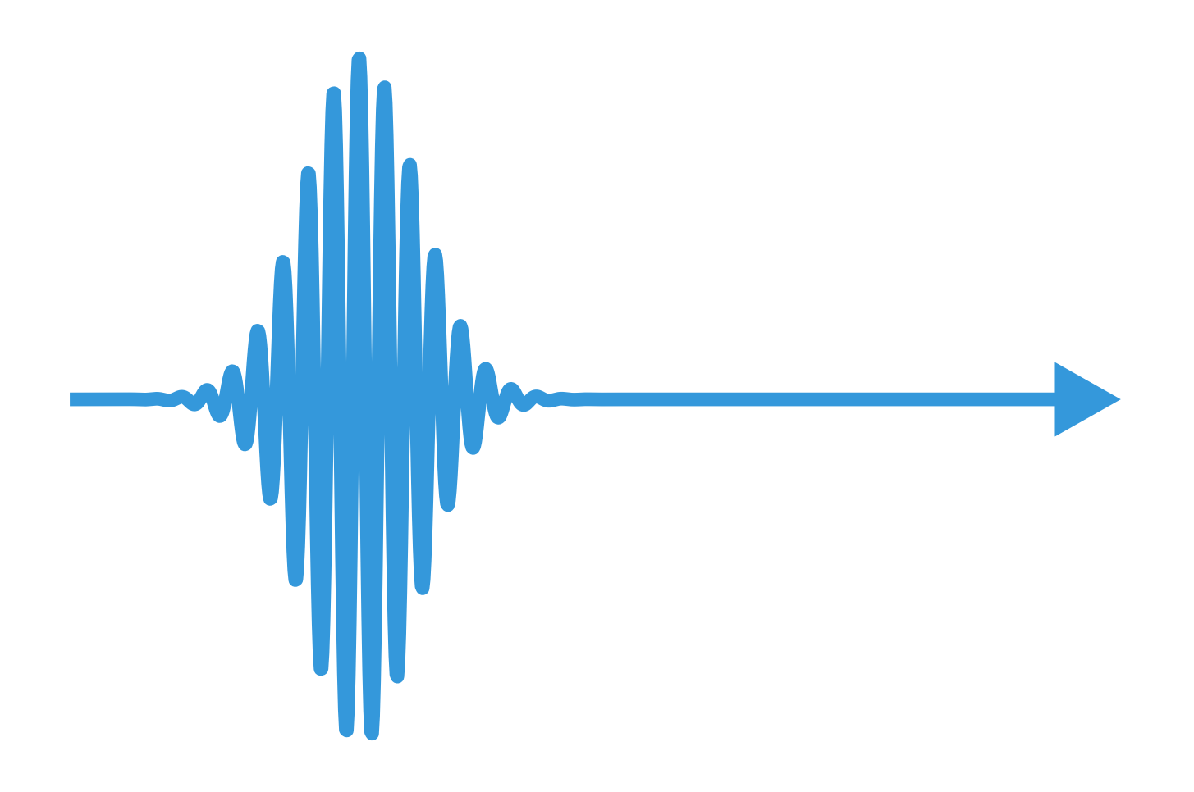
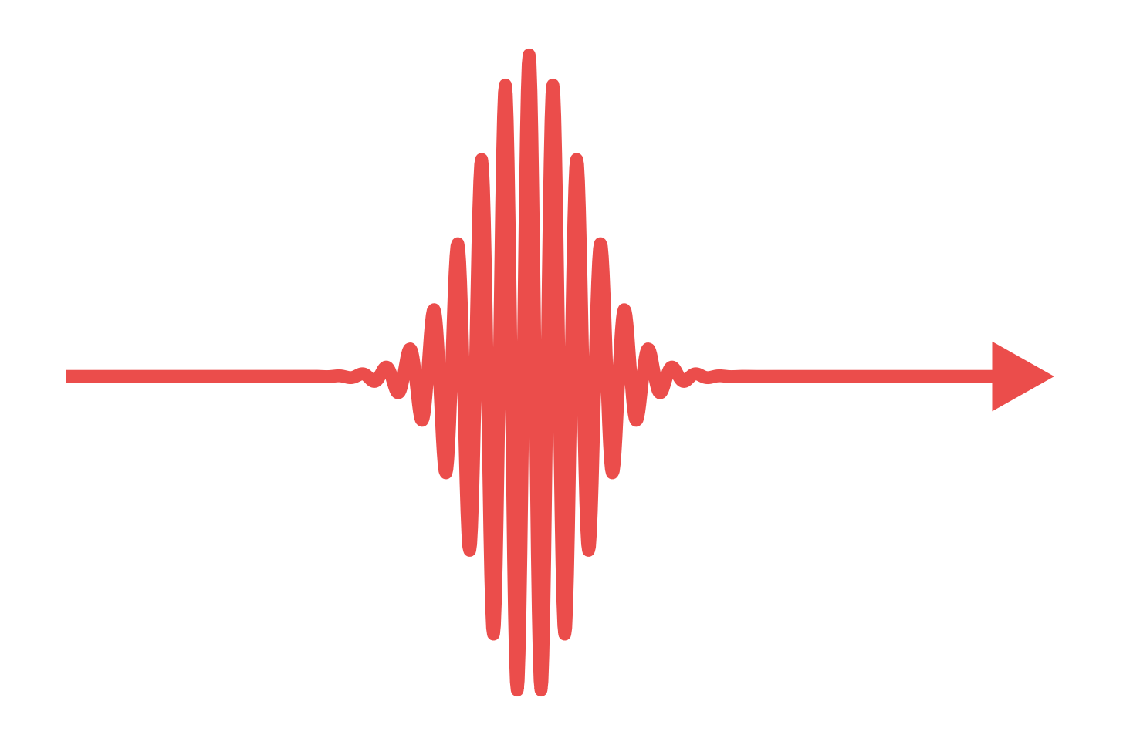
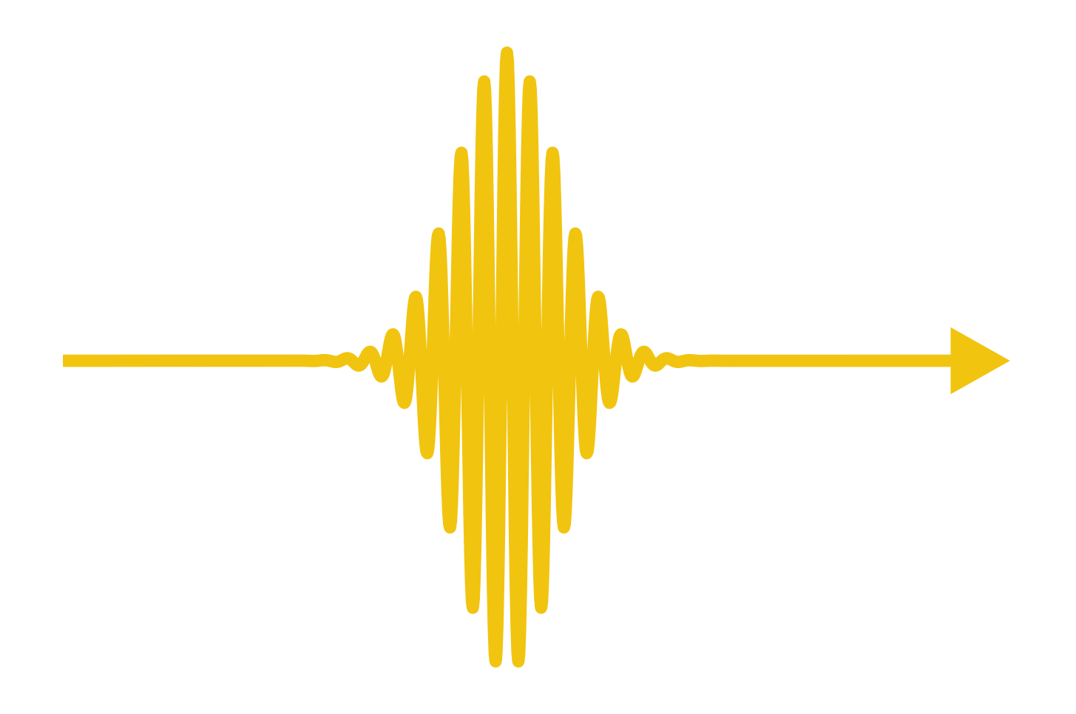

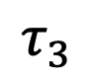
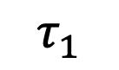
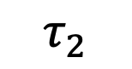
2DES setup
$$τ_{1}$$
$$τ_{2}$$
$$τ_{3}$$
$$S^{\left(3\right)}\left(t_{3},t_{2},t_{1}\right)∝i^{3}\left\langle µ[µ(t_{3}),[µ\left(t_{2}\right),\left[µ\left(t_{1}\right),ρ\right]]]\right\rangle$$

Slide 7
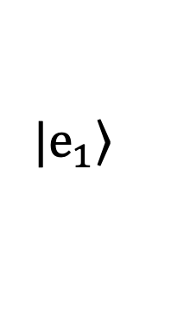
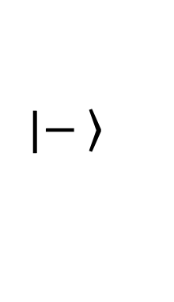
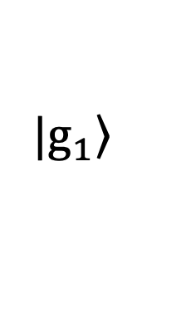
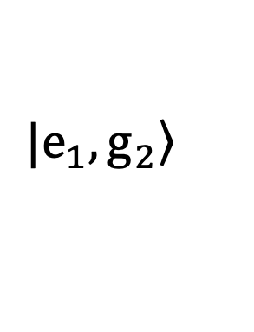
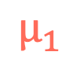
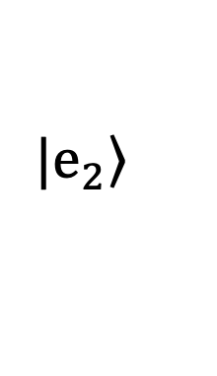
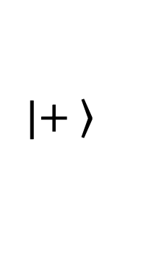
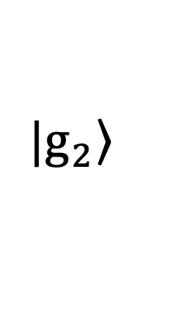
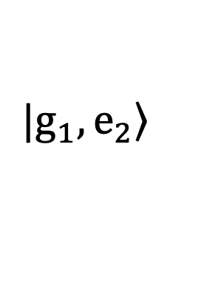
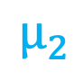
Exciton basis
$$|\left.+ \right\rangle$$
$$|\left.e_{2}\right\rangle$$
$$|\left.e_{1}\right\rangle$$
$$μ_{1}$$
$$μ_{2}$$
$$|\left.g_{1}\right\rangle$$
$$|\left.g_{2}\right\rangle$$
$$|\left.e_{1},g_{2}\right\rangle$$
$$|\left.g_{1},e_{2}\right\rangle$$
$$|\left.− \right\rangle$$

Slide 8
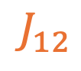
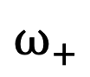
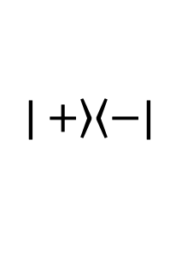
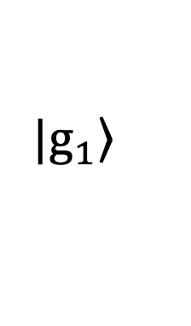


















Interpreting the 2D map
Exciton basis
Eigen basis
2DES map
$$J_{12}$$
$$|\left.e_{2}\right\rangle$$
$$|\left.+\right\rangle$$
$$|\left.e_{1}\right\rangle$$
$$ω_{+}$$
$$|\left.−\right\rangle$$
$$\left.|+\right\rangle \left\langle −\right.|$$
$$\left.|+\right\rangle \left\langle +\right.|$$
$$μ_{1}$$
$$μ_{2}$$
$$μ_{+}$$
$ω$_{det}
$$μ_{−}$$
$$|\left.g_{1}\right\rangle$$
$$ω_{−}$$
$$\left.|−\right\rangle \left\langle −\right.|$$
$$|\left.g_{2}\right\rangle$$
$$|\left.g_{1},g_{2}\right\rangle$$
$$\left.|+\right\rangle \left\langle −\right.|$$
Diagonal peaks = Eigenstates of the system
Cross peaks = Coherence transfer between states
Diagonally elongated shape = Inhomogenous broadening
Symmetric shape = Homogenous broadening
$$ω_{−}$$
$ω$_{exc}
$$ω_{+}$$

Slide 9








Simulating 2DES with $ℒ$-PLDM
PLDM
$$\hat{ρ}=\sum_{αβ}{ρ_{αβ}(R)\left.|α\right\rangle \left\langle β|\right.}→ρ_{αβ}(R){\hat{a}}_{α}^{†}{\hat{a}}_{β}$$
An operator is represented by forward and backward wavefunctions.
Nuclei get feedback from the wavefunctions
𝛌
$$Γ$$
Lindblad
$$λ$$
$$Γ$$
PLDM
Lindblad
The loss operator is of the form
Lindblad
PLDM
Lindblad

Slide 10




















The algorithm
$${\hat{μ}}_{0}{\hat{ρ}}^{(0)}$$
$$ℒ$$
[${\tilde{ρ}}^{\left(1\right)}]$
$$t_{1}$$
$${\tilde{ρ}}^{\left(1\right)}(t_{1})$$
$${{\tilde{ρ}}^{\left(1\right)}\hat{μ}}_{1}$$
$$ℒ$$
$${[\tilde{ρ}}^{\left(2\right)}]$$
Focus
$$t_{2}$$
$${\tilde{ρ}}^{\left(2\right)}(t_{2})$$
$${\tilde{ρ}}^{(2)}$$
$${{\tilde{ρ}}^{\left(2\right)}\hat{μ}}_{2}$$
Focus
$$ℒ$$
$${[\tilde{ρ}}^{\left(3\right)}]$$
$$t_{3}$$
$${\tilde{ρ}}^{(3)}$$
$${\tilde{ρ}}^{\left(3\right)}(t_{3})$$
J. Chem. Phys. 159, 094102 (2023)

Slide 11
















Linear spectra of Polaritons
$$g_{c}$$
$$|\left.e\right\rangle$$
$$|\left.1\right\rangle$$
(a)
$$Γ=0meV$$
(b)
$$Γ=10meV$$
$$μ_{1}$$
$$Γ$$
$$|\left.g\right\rangle$$
$$|\left.0\right\rangle$$
Absorption (Normalized)
(c)
(d)
$$Γ=50meV$$
$$Γ=100meV$$
J. Chem. Phys. 159, 094102 (2023)

Slide 12








2DES of a monomer in cavity
$$Γ=0meV$$
Outside Cavity
$$Γ$$
$$Γ=20meV$$
Inside Cavity
J. Chem. Phys. 159, 094102 (2023)

Slide 13























2DES of dimer in cavity
Model
2DES
$$|\left.e_{1},e_{2}\right\rangle$$
$$\sqrt{2}g_{c}$$
$$|\left.2\right\rangle$$
$$μ_{2}$$
$$μ_{1}$$
$$J_{12}$$
$$2Γ$$
$$\left.|−\right\rangle \left\langle +\right.|$$
$$\left.|+\right\rangle \left\langle +\right.|$$
$$|\left.g_{1},e_{2}\right\rangle$$
$$|\left.1\right\rangle$$
$$|\left.e_{1},g_{2}\right\rangle$$
$$g_{c}$$
$$\left.|−\right\rangle \left\langle −\right.|$$
$$\left.|+\right\rangle \left\langle −\right.|$$
$$μ_{1}$$
$$μ_{2}$$
$$Γ$$
$$|\left.g_{1},g_{2}\right\rangle$$
$$|\left.0\right\rangle$$
$λ$ = 24.7 meV
$ω$ = 24.7 meV
$ε$ = 2.0 eV
g_{c} = 24.7 meV
J. Chem. Phys. 159, 094102 (2023)
Notes:
Only the off-diagonals and try to contract the information

Slide 14


2DES of dimer in cavity
Vary g_{c}
Vary $Γ$
Electronic coherence much longer than natural dimer
Even at high loss, coherence can be enhanced to 3x of dimer.
J. Chem. Phys. 159, 094102 (2023)

Slide 15






N-molecule expense
2 molecules
4 molecules
25 molecules
Expensive !!!
Hamiltonian
# states ∝ N²
Hilbert space ∝ N⁴
But … wait a minute !
Dipole
Symmetric structure
Super sparse
Cost can be actually reduced to N²

Slide 16


N-molecule Linear Spectra
N = 2
N = 4
Rabi splitting scales as 2$\sqrt{N}$g_{c.}
Width decrease with increase of N as a direct result of polaron decoupling.
N = 9
N = 25
N = 100
N = 400

Slide 17



Polaron decoupling
2 molecules
4 molecules
8 molecules
Reduction of slope tilt with increasing molecules

Slide 18


Coherence Enhancement
Cross peak oscillations
Diagonal peak oscillations

Slide 19






Future goals : I (Theory)

Slide 20









Future goals : II (Computational)

Slide 21










Future goals : III (Applications)
Effects of energetic and dipole disorder on 2DES lineshapes and coherence lifetime.
Detailed study of 2DES lineshapes for different matter bath and determining the effect of polaron decoupling on coherence transfer.
Is it possible to probe polaritonic dark states in 2DES?
$$|\left.e_{1}\right\rangle$$
$$|\left.e_{2}\right\rangle$$
$$|\left.e_{3}\right\rangle$$
$$|\left.e_{4}\right\rangle$$
$$μ_{1}$$
$$μ_{3}$$
$$μ_{2}$$
$$μ_{4}$$
$$|\left.g\right\rangle$$
$$|\left.g\right\rangle$$
$$|\left.g\right\rangle$$
$$|\left.g\right\rangle$$

Slide 22



Acknowledgements
DE-SC0022171
Computational resources
CENTRE
for
INTEGRATED
RESEARCH
COMPUTING

Slide 23

















































Pulse sequences and Feynman diagrams
SE
GSB
ESA
$$\left.|g\right\rangle \left\langle g|\right.$$
$$\left.|g\right\rangle \left\langle g|\right.$$
$$\left.|e3\right\rangle \left\langle e2|\right.$$
$$\left.|e_{1}\right\rangle \left\langle g|\right.$$
$$\left.|e_{2}\right\rangle \left\langle g|\right.$$
$$\left.|f\right\rangle \left\langle e2|\right.$$
Non-Rephasing
$$t_{3}$$
$$t_{3}$$
$$t_{3}$$
$$e^{−iωt}$$
$$\left.|e_{1}\right\rangle \left\langle e_{2}|\right.$$
$$\left.|g\right\rangle \left\langle g|\right.$$
$$\left.|e1\right\rangle \left\langle e2|\right.$$
$$t_{2}$$
$$t_{2}$$
$$t_{2}$$
$$\left.|e_{1}\right\rangle \left\langle g|\right.$$
$$\left.|e_{1}\right\rangle \left\langle g|\right.$$
$$\left.|e1\right\rangle \left\langle g|\right.$$
$$t_{1}$$
$$t_{1}$$
$$t_{1}$$
$$\left.|g\right\rangle \left\langle g|\right.$$
$$\left.|g\right\rangle \left\langle g|\right.$$
$$\left.|g\right\rangle \left\langle g|\right.$$
$$t$$
$$\left.|g\right\rangle \left\langle g|\right.$$
$$\left.|g\right\rangle \left\langle g|\right.$$
$$\left.|e3\right\rangle \left\langle e1|\right.$$
$$e^{iωt}$$
$$\left.|e_{2}\right\rangle \left\langle g|\right.$$
$$\left.|e_{2}\right\rangle \left\langle g|\right.$$
$$\left.|f\right\rangle \left\langle e1|\right.$$
$$t_{3}$$
$$t_{3}$$
$$t_{3}$$
Rephasing
$$\left.|e_{2}\right\rangle \left\langle e_{1}|\right.$$
$$\left.|g\right\rangle \left\langle g|\right.$$
$$\left.|e2\right\rangle \left\langle e1|\right.$$
$$t_{2}$$
$$t_{2}$$
$$t_{2}$$
$$\left.|g\right\rangle \left\langle e_{1}|\right.$$
$$\left.|g\right\rangle \left\langle e_{1}|\right.$$
$$\left.|g\right\rangle \left\langle e1|\right.$$
$$t_{1}$$
$$t_{1}$$
$$t_{1}$$
$$\left.|g\right\rangle \left\langle g|\right.$$
$$\left.|g\right\rangle \left\langle g|\right.$$
$$\left.|g\right\rangle \left\langle g|\right.$$

Slide 24













